Slide 1


SMART DRIVE

Slide 2
PROBLEM BEING ADDRESSED
Though Driving has made moving easier, there are a few issues that disturb the smooth flow of the traffic like:
Increase in pollution
Traffic collision(Interaction of one vehicle with another vehicle)

Slide 3
SOLUTION
Sensors embedded along the corners of the car to the detect the obstacle distance(ultra sonic sensor) and notify if any limitation of distance is violated.
The application in the car allow driver to check if the driver is in the safe zone.
The application notifies using audio by connecting the WiFi to the speakers.
The sensors activate the LEDs to catch the attention of fellow drivers.
The sensor will activate the Buzzer and with increasing volume to notify other users.

Slide 4
PRODUCT/SERVICE
The proposed system is an IOT based application that notifies the driver in a situation that may lead to collision of vehicles with varying intensity of light and buzzer sound.

Slide 5
PROPOSED MODEL FOR SMART DRIVE:
Buzzer
Arduino UNO
Node MCU
Ultrasonic Sensors
Cloud Platform
LEDs
Android Application
(MIT App Inventor)
Driver
Text to Speech notifications
(via Node- Red Flow)

Slide 6
MARKET
Customers :
Small scale Car manufacturing companies.
OLA and UBER Cabs
We reach the customers though garages and then move onto small scale car manufacturing x

Slide 7
COMPETITION
Competitors:
NISSAN Company, Forbes, Tata Motors
How have they succeeded :
They have included Moving Object Detection (MOD) Technology in their cars.
Alerting the driver to moving objects around the vehicle By detecting moving objects around the car and alerting the driver, this technology enhances safety when pulling out of a parking space, helping give drivers better awareness of their surroundings and increased peace of mind.

Slide 8
UNIQUE SELLING QUALITY OF PRODUCT
Not only through the Buzzer sound we are notifying the drivers through varying intensity of LED’s and Text to speech notification

Slide 9
REVENUE MODEL
Price of our product :
Ultra Sonic + Buzzer = 1349/-
Total Price of the Selling Product: 5000 – 6000/-
Arduino + Wifi Module = 679/-
Car lamp – 2 pieces = 1000/-

Slide 10
FINANCIALS
Cost of making the product
INR 4000
Month-wise revenue for at least one year:
1 month(50 devices) = 2,50,000 – 3,00,000/-
1month profit = 1,50,000 – 2,00,000/-
1 year (Around 600 devices) = 30L – 36L
1 year profit = 6L – 12L

Slide 11
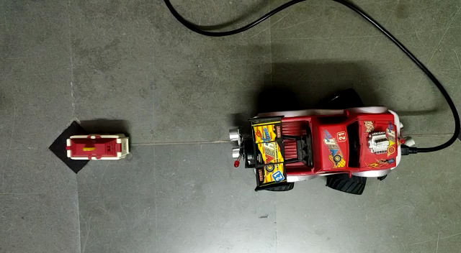
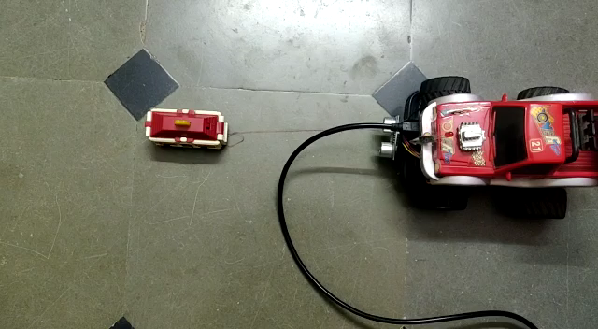

Slide 12

QUERIES?

Slide 13
TEAM
K. Keerthana
R. Nikitha
B. Sai Tulasi
N. Lakshmi Vyshnavi
G. Sridevi
N. Lakshmi Manasa

